Slide 1
Data Analytics For Business
Final Mini Project

Slide 2
Understand Business Problem

Slide 3
CRISA Consumer Segmentation
Problem:
How can CRISA segment the market based on two key sets of variables more directly related to the purchase process and to brand loyalty
Two key sets are: Purchase behavior and Basis of purchase

Slide 4
Understand Data

Slide 5
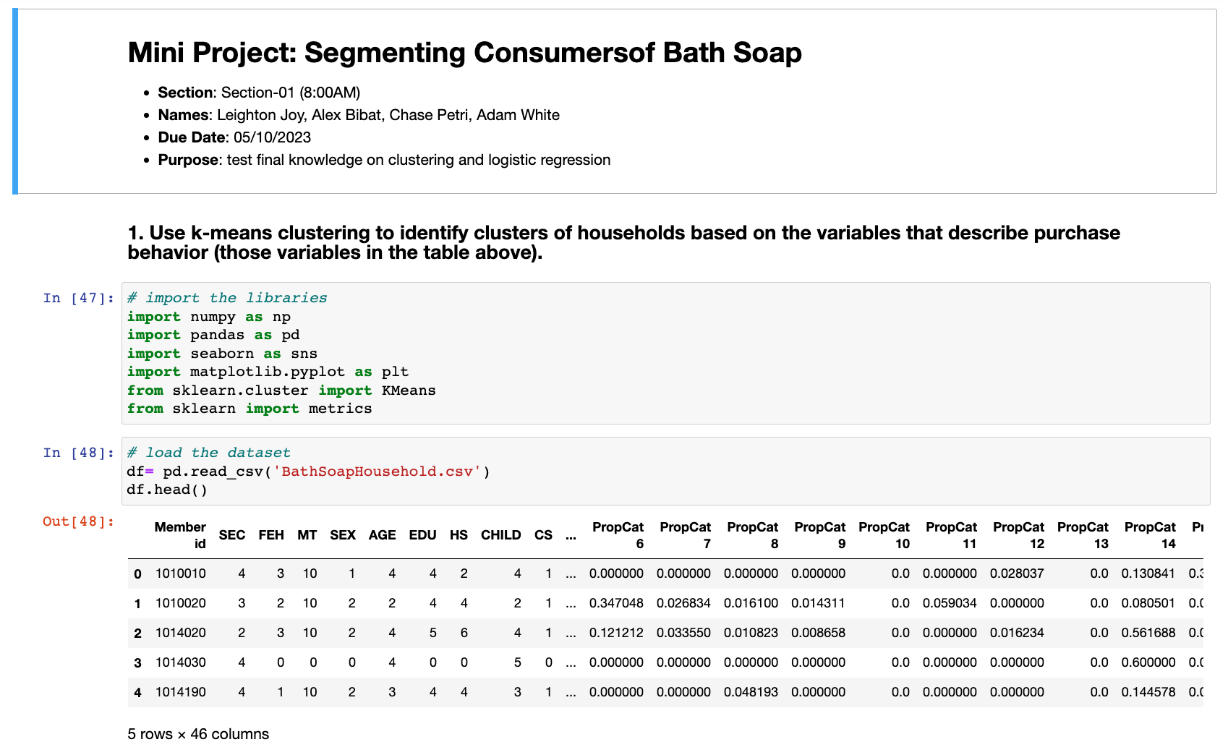
Importing Libraries and Read in CSV File
Imported the libraries need to run the mini project
We displayed the top values to see what the data was like

Slide 6
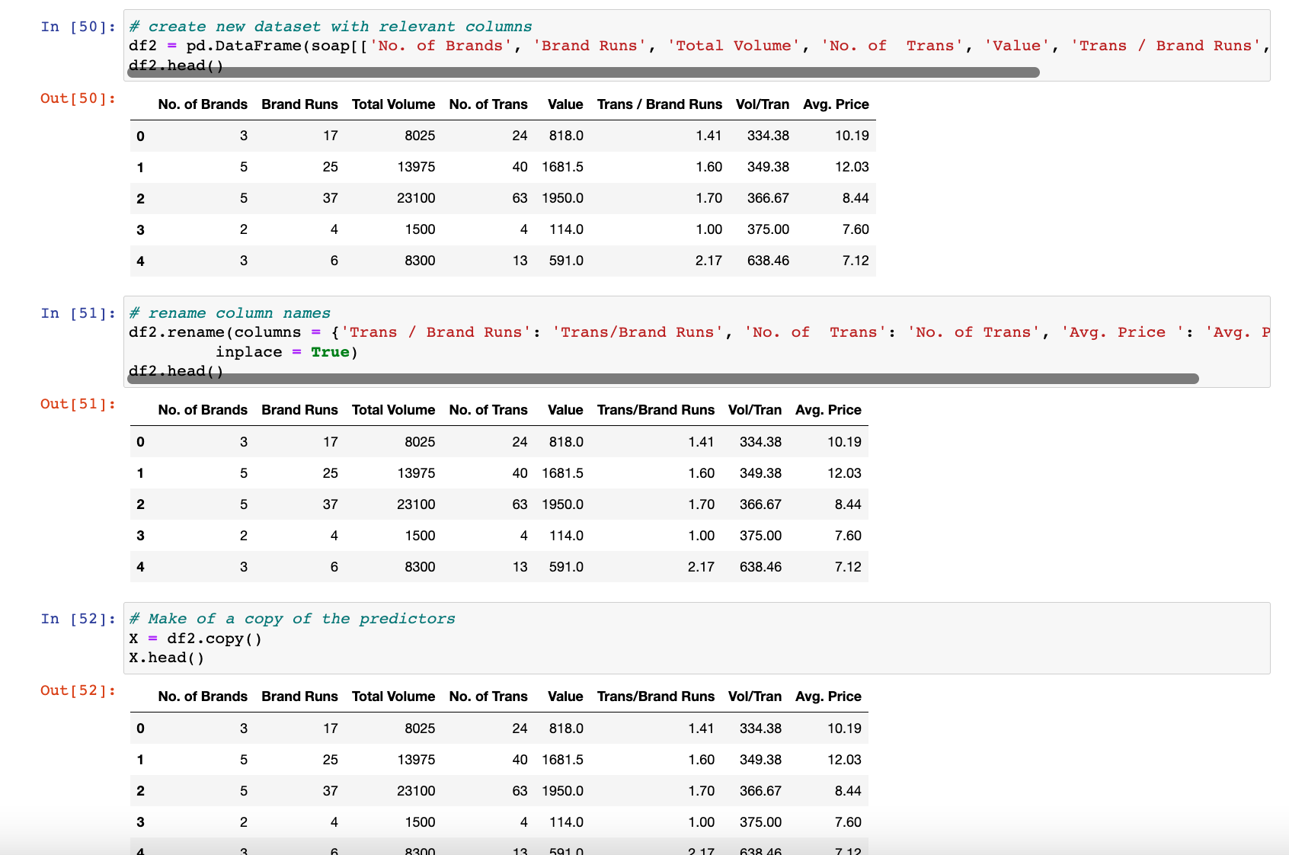
Rename Columns and Assign X to Independent Variables
Then we created a copy of the original data
Rename the columns to work with the libraries

Slide 7
Clustering

Slide 8
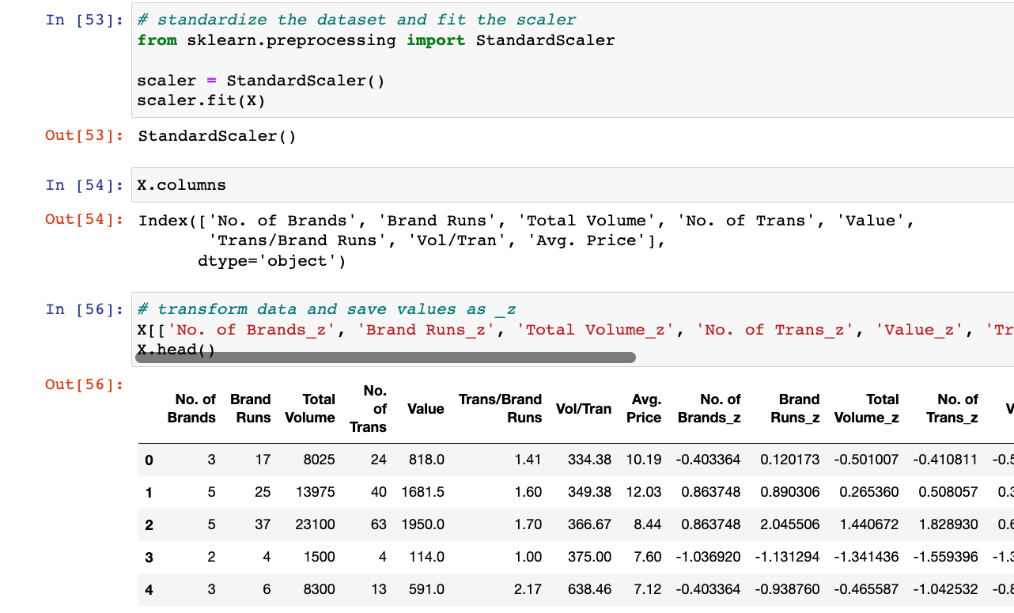
Scale Independent Variables
We needed to scale the data with StandardScaler
We used the new scaled values to create new columns with _z after them

Slide 9
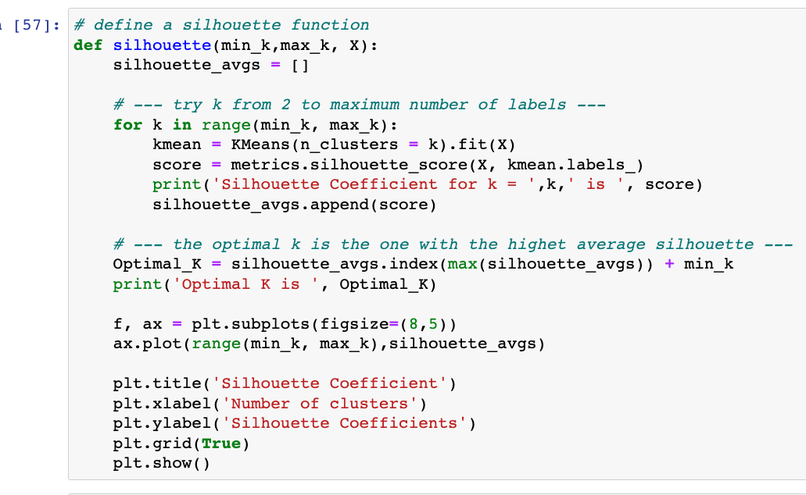
Create Silhouette Function To Find Optimal K
Code to run a silhouette from sklearn to find the ideal number of clusters

Slide 10
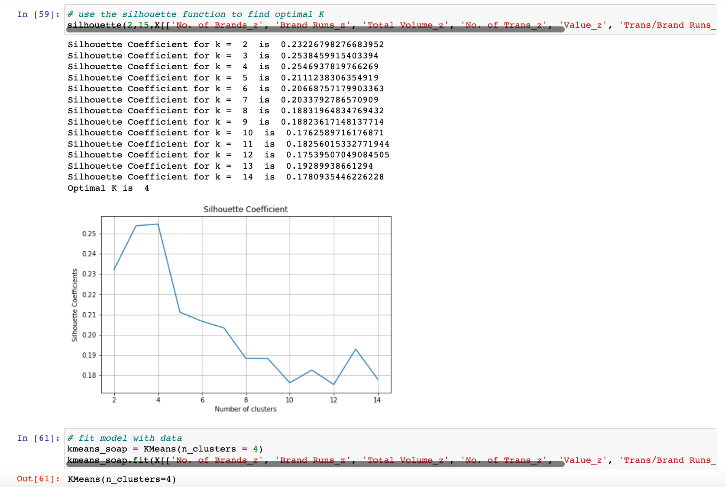
Observe Silhouette Coefficients to Find Optimal K
We ran a silhouette from sklearn to find the optimal K. The K value is the optimal number of clusters for our data set

Slide 11
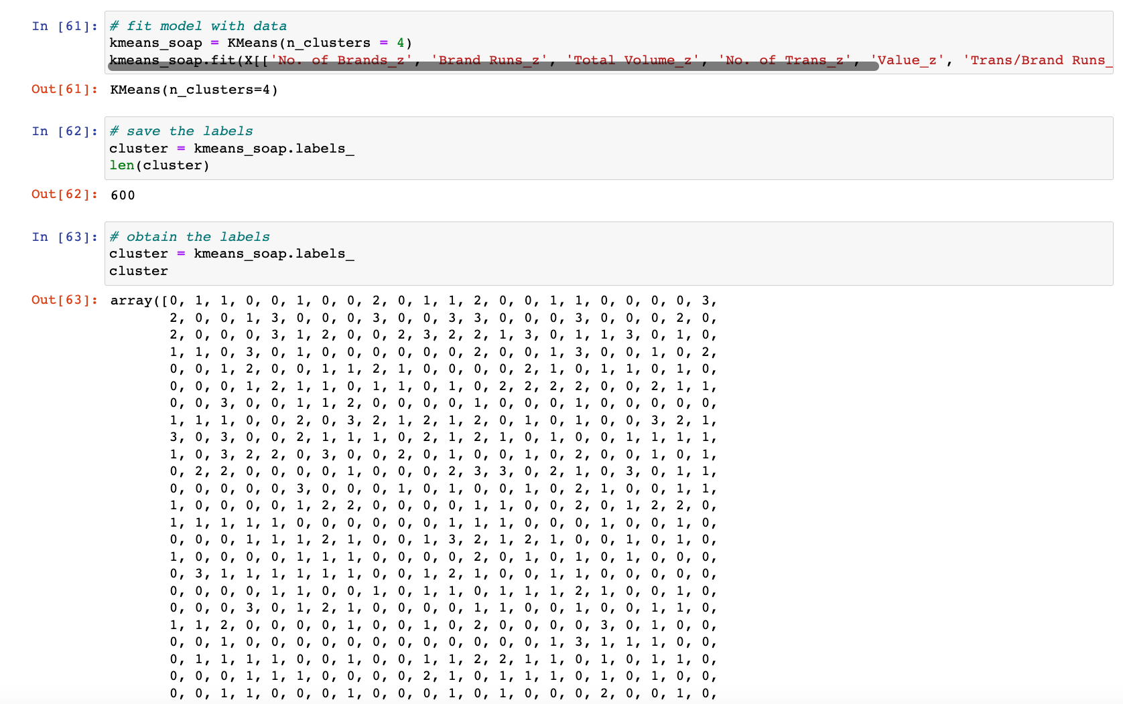
Create K Means Cluster With Optimal K
Here we fit the model with the data and then printed the 600 values. These are the clusters which the values have been assigned to 0-3

Slide 12
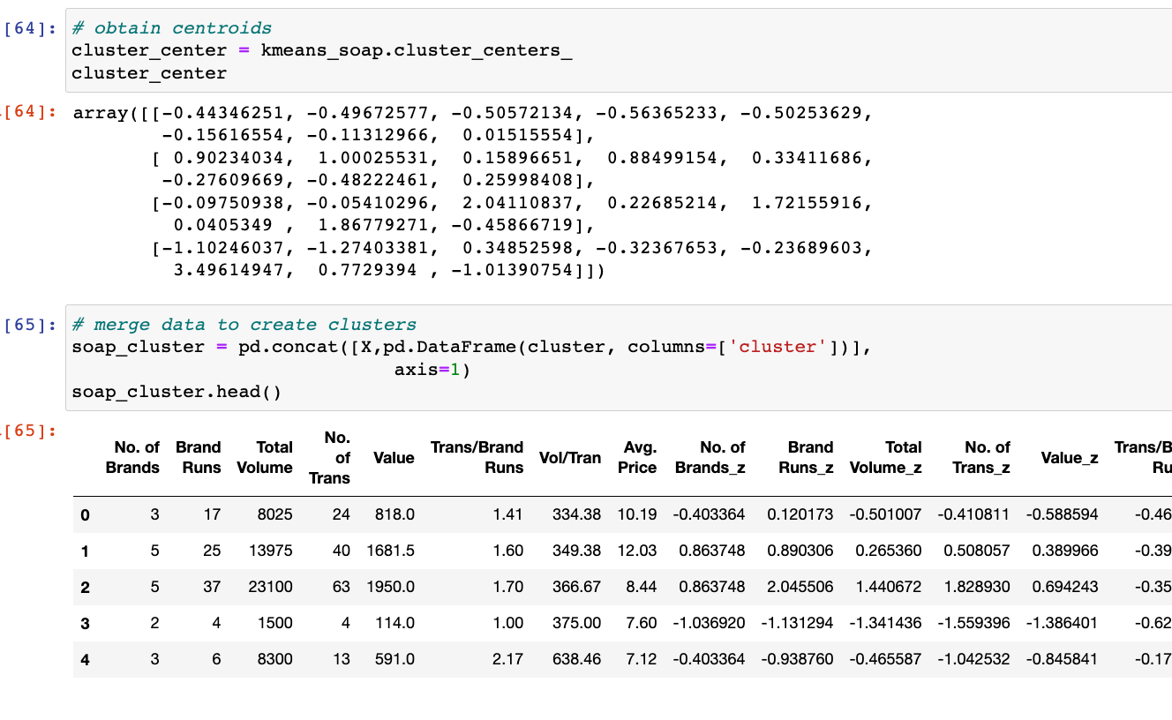
Find Cluster Centers and Add Them to a Dataframe
Found the centroids of the data

Slide 13
Logistic Regression

Slide 14
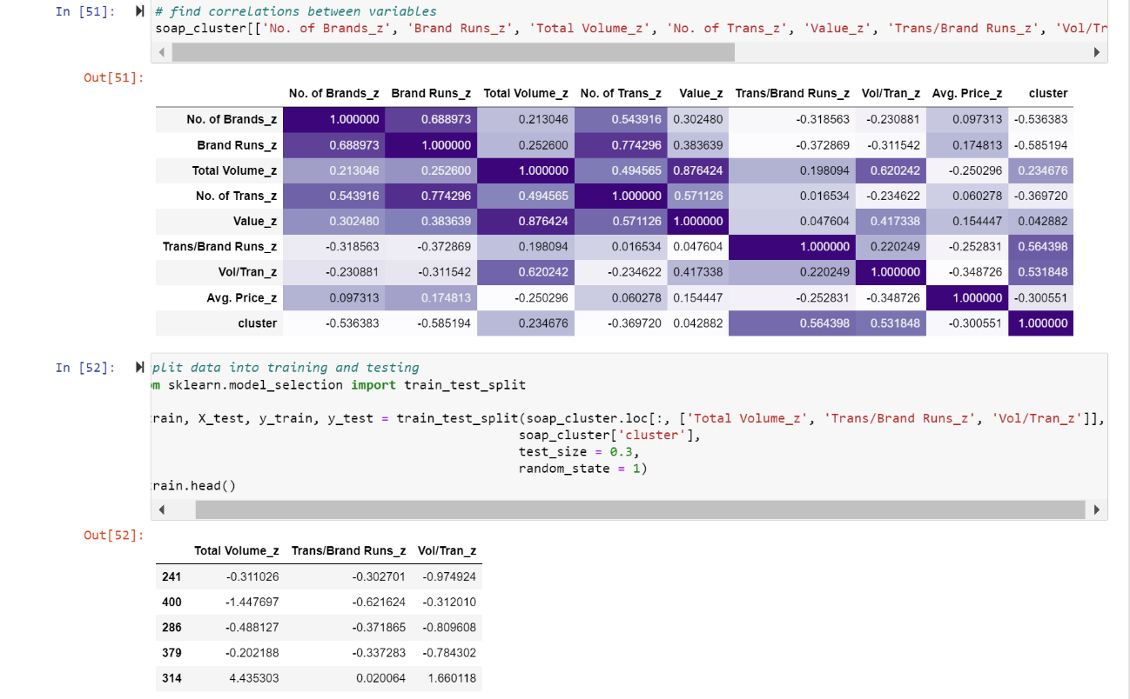
Find Impactful Independent Variables And Split Variables into Test and Train
The most impactful variables were:
Trans/Brand_Runs_z
Vol/Tran_z
Total_Volume_z
Then we split the data into training and testing with 70% of the values used for training

Slide 15
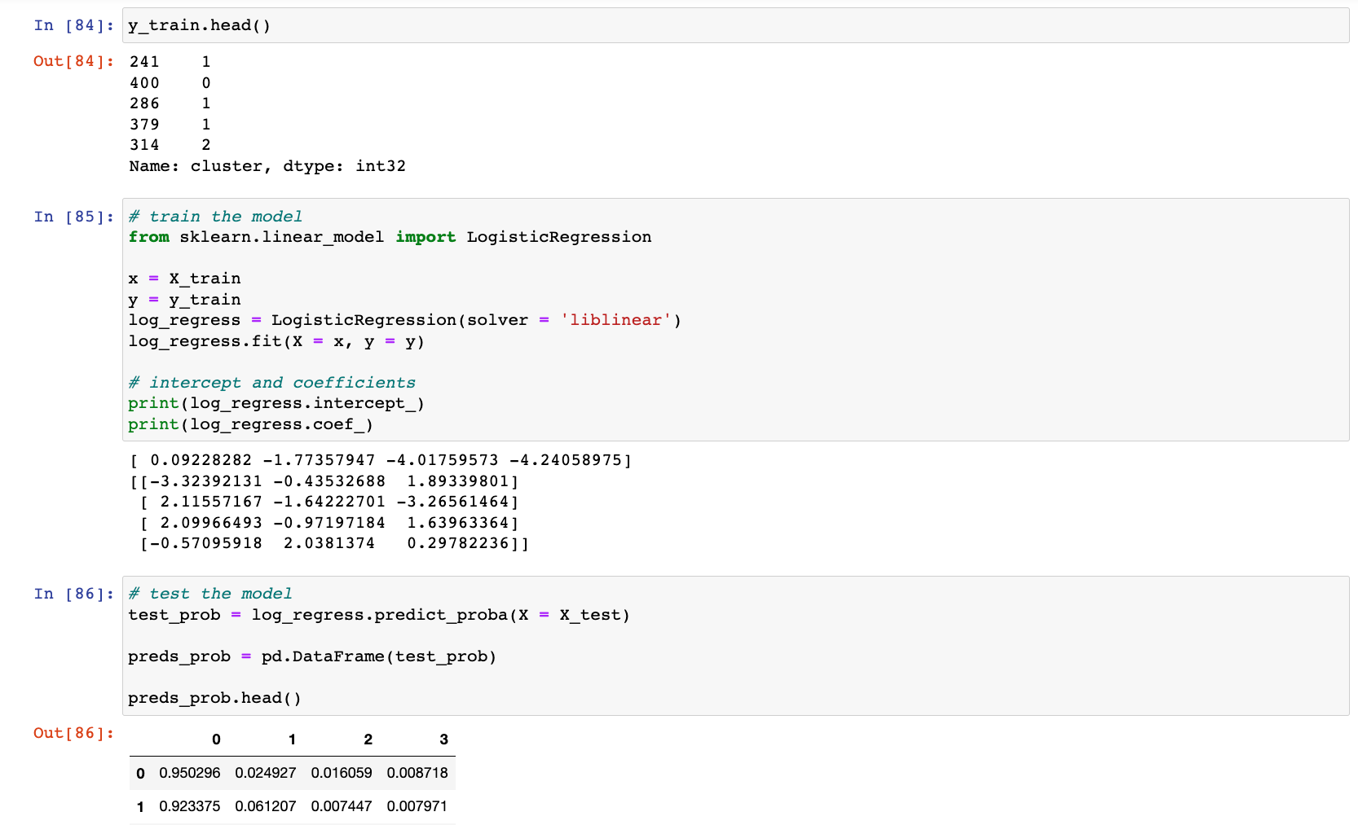
Create Linear Regression Model and Get Prediction Probabilities
Train and test the model

Slide 16
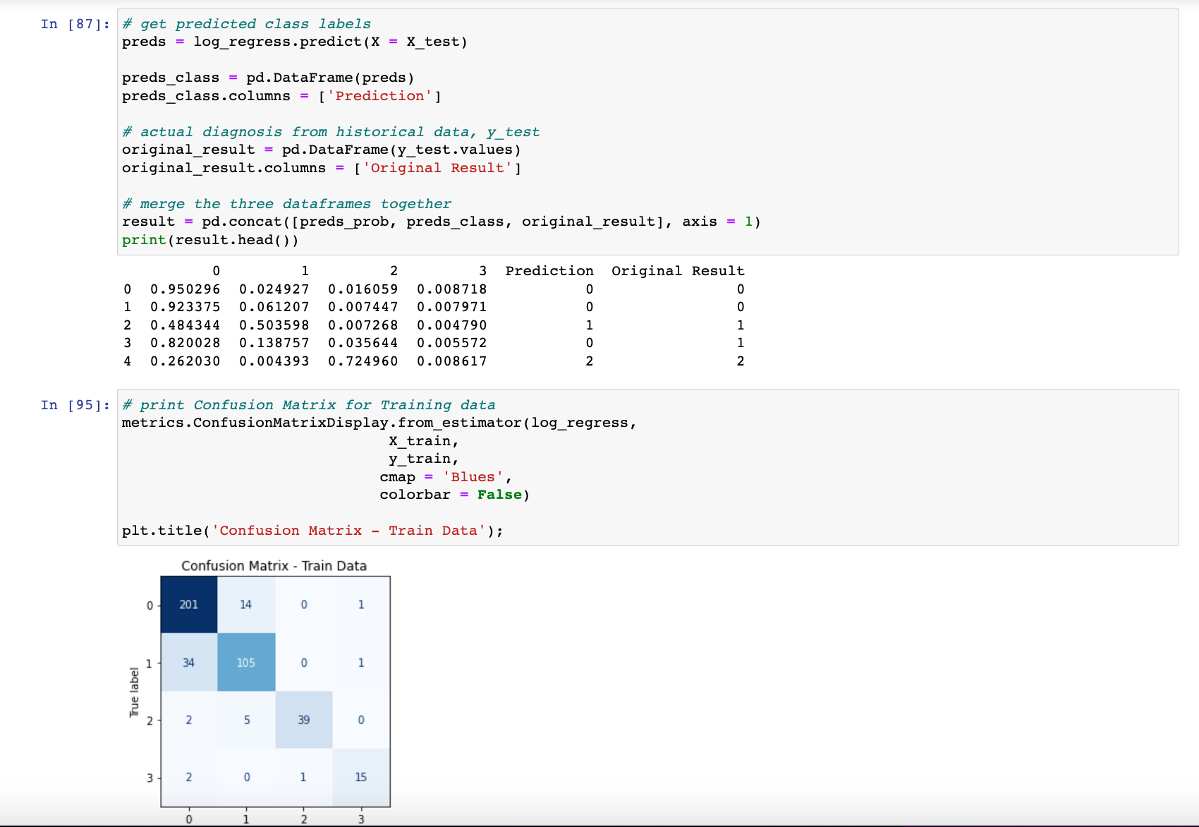
Retrieve Predictions Part 1

Slide 17
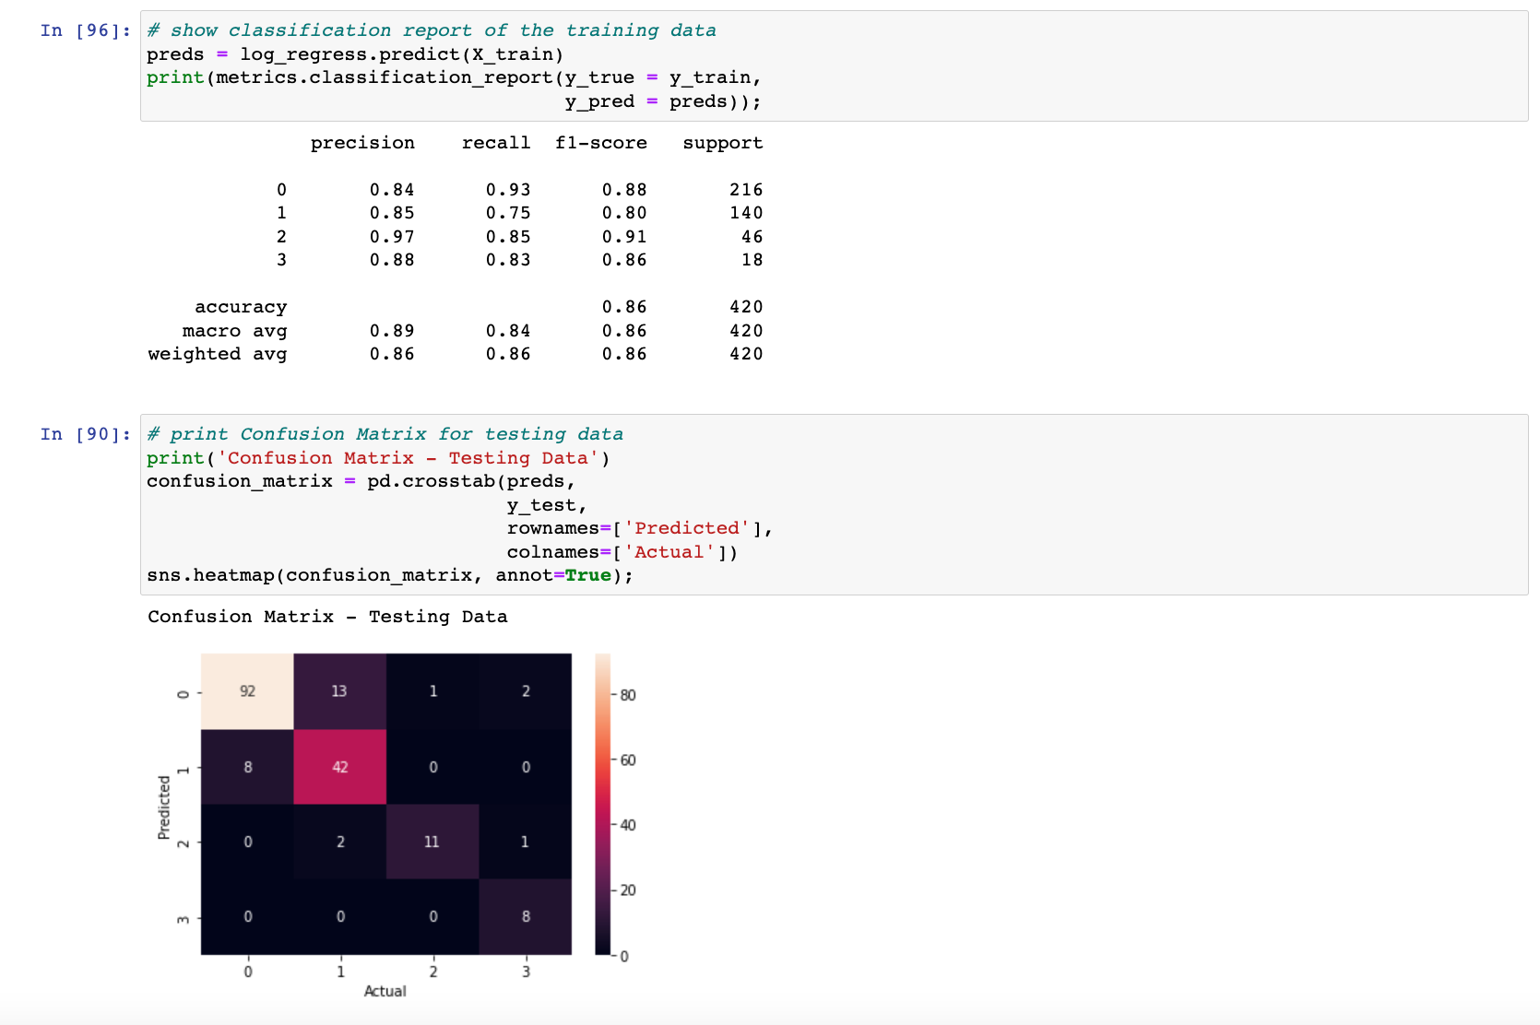
Retrieve Predictions Part 2
Run a metrics

Slide 18
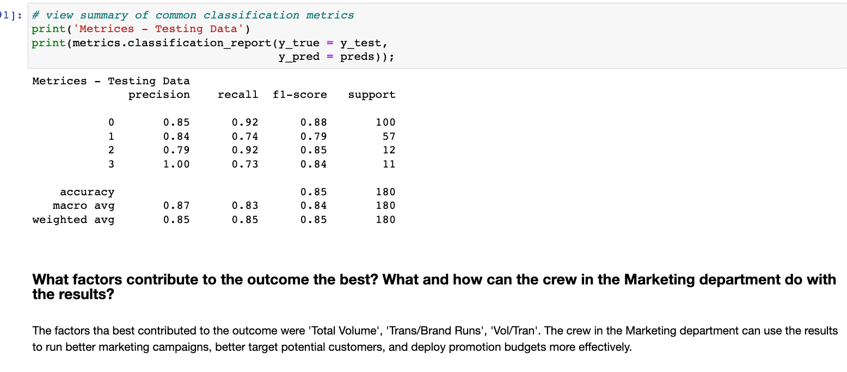
Print Classification Report

